Slide 1

Intro and sample project demo

Slide 2
Intro
Server side rendered with island hydration
Based on Deno (node alternative)
Used with preact
Not easy to replace Preact: https://github.com/denoland/fresh/issues/956
Has filebased routes, dynamic routes, middleware, router handlers
Alot like Next.js
Deno vscode extension

Slide 3
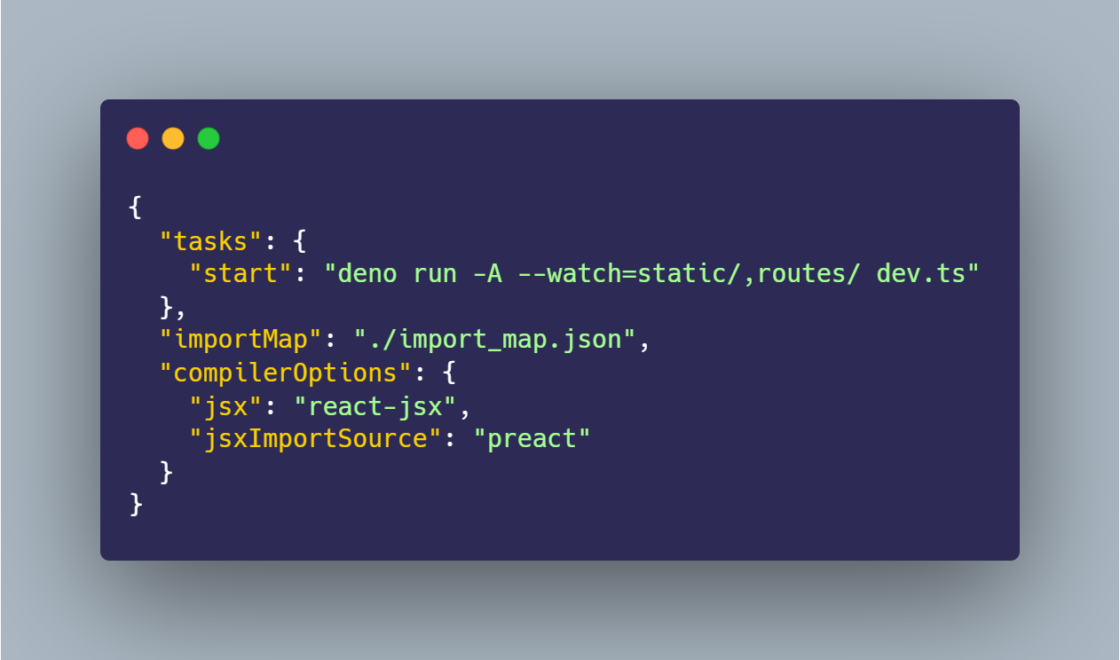
Deno.json & import_map.json
Uses json config file
Config points to a import map
Import map is
”Deno task start”

Slide 4
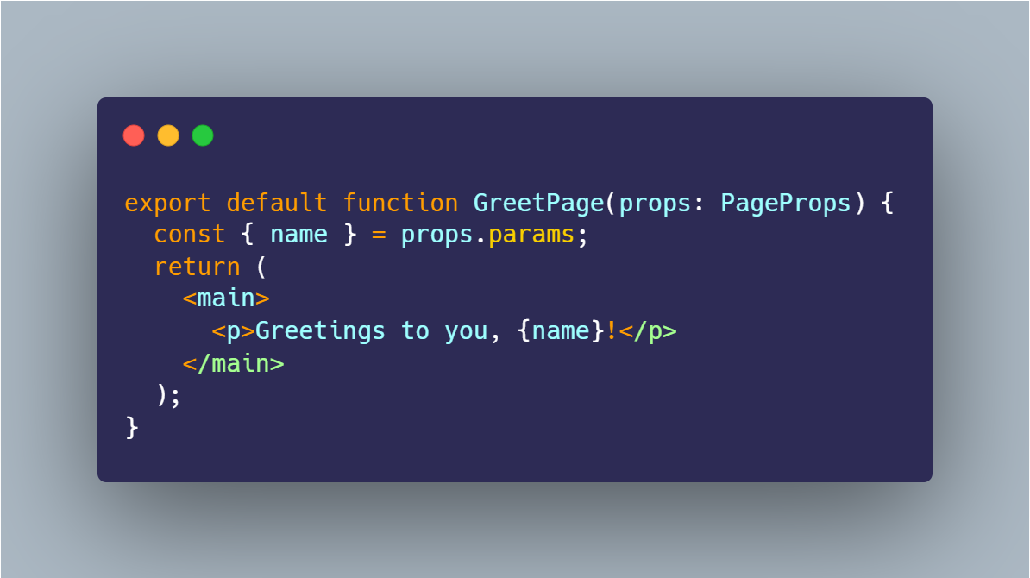
Routes
Filesystem routes
Static routes /page
Dynamic routes /page/:name
Api routes ‘/api’ prefix

Slide 5
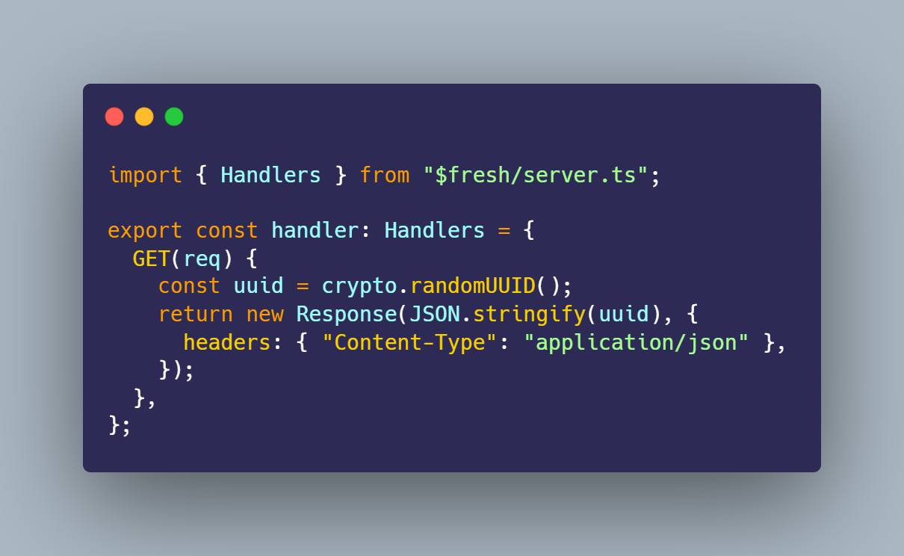
Route handlers
Access to request and resonse
Must return a response
Can be used for api and routes

Slide 6
Fetching data (ctx.render(data))
Data passed to ctx.render
Accessible trough props.data
http://localhost:8000/fetching/rsh-collab

Slide 7
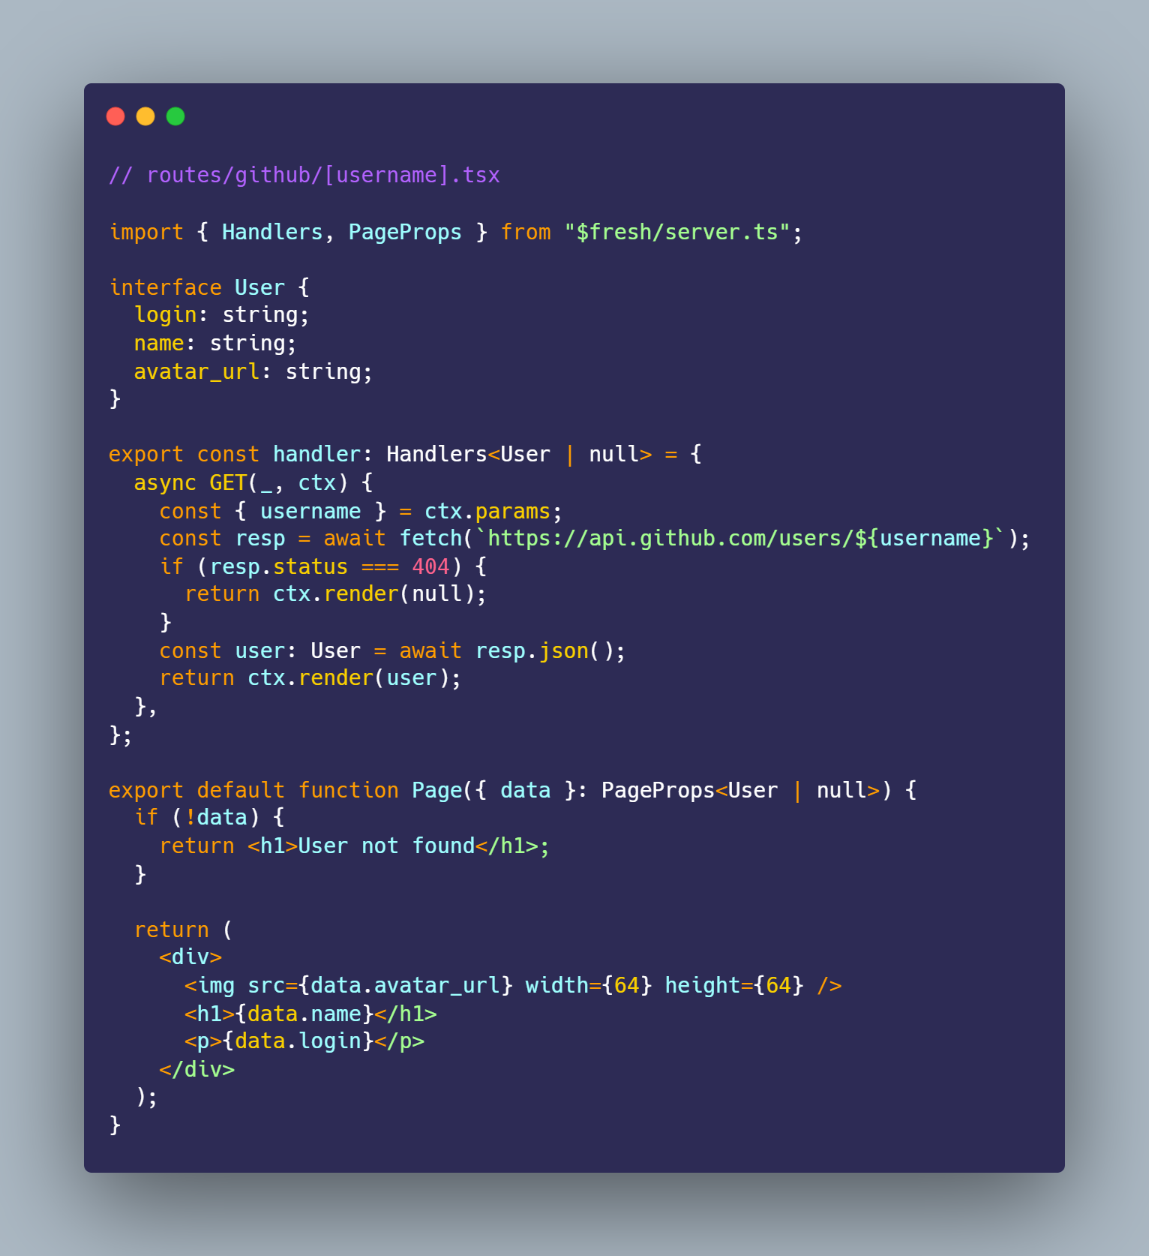

Slide 8
Islands
All content is rendered serverside
Small components can be hydrated on the go
Have to be in /islands

Slide 9

Styling
Wat
Tailwind seems to be the most ”official” choice
https://www.reddit.com/r/Deno/comments/x7n2hz/how_to_apply_global_css_rules/

